Slide 1


ENGLISH

Slide 2

Sumário
Present Simple – página 3
Past Simple – página 11
Present Continuous (I am doing) – página 19
Past Continuous (I was doing) – página 26
Present Perfect (I have done) – página 33
Past Perfect (I had done) – página 41

Slide 3
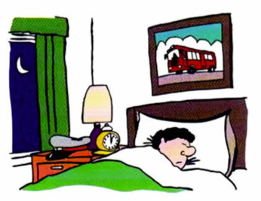
Present Simple
Study this example situation:
Alex is a bus driver, but now he is in bed asleep.
He is not driving a bus. (He is asleep.)
but He drives a bus. (He is a bus driver.)
Drive(s)/work(s)/do(es) etc. is the present simple:

Slide 4
Present Simple
a) We use the present simple to talk about things in general. We use it to say that something happens all the time or repeatedly/ or that something is true in general:
• Nurses Look after patients in hospitals.
• I usually go away at weekends.
• The earth goes round the sun.
• The cafe opens at 7.30 in the morning.
Remember:
I work ... but He works ... They teach ... but My sister teaches ...

Slide 5
Present Simple
b) We use do/does to make questions and negative sentences:
• I come from Canada. Where do you come from?
• I don't go away very often.
• What does this word mean? (not What means this word?)
• Rice doesn't grow in cold climates.
In the following examples, do is also the main verb (do you do I doesn’t do etc.):
• 'What do you do?' 'I work in a shop.'
• He's always so lazy. He doesn't do anything to help.

Slide 6
Present Simple
c) We use the present simple to say how often we do things:
• I get up at 8 o'clock every morning.
• How often do you go to the dentist?
• Julie doesn't drink tea very often.
• Robert usually goes away two or three times a year.
d) I promise / I apologise etc.
Sometimes we do things by saying something. For example, when you promise to do something, you can say 'I promise ...'; when you suggest something, you can say 'I suggest ...':
• I promise I won't be late. (not I'm promising)
• 'What do you suggest I do?' 'I suggest that you ... '
In the same way we say: I apologise .. . / I advise ... / I insist ... / I agree ... / I refuse ... etc.

Slide 7
Present Simple
Exercises:
1. Complete the sentences using the following verbs:
cause(s) connect(s) drink(s) Live(s) open(s) speak(s) take(s)
a. Tanya speaks German very well.
b. I don't often ........................ coffee.
c. The swimming pool ………........... at 7.30 every morning.
d. Bad driving ……………........ many accidents.
e. My parents ..... ................. in a very small flat.
f. The Olympic Games …................................... place every four years.
g. The Panama Canal ................................. the Atlantic and Pacific Oceans.

Slide 8
Present Simple
2. Put the verb into the correct form.
a. Julie doesn’t drink (not / drink) tea very often.
b. What time..................................................... (the banks / close) here?
c. I’ve got a car, but I .............................................(not / use) it much.
d. ‘Where. …………………………….(Ricardo/ come) from? ‘From Cuba.’
e. What………………………………..(you / do)?’ `I’m an electrician.’
f. It………………………………..(take) me an hour to get to work. How long ..................................................................................(it I take) you?
g. Look at this sentence. What ............................................................. (this word / mean)?
h. David isn't very fit. He ………………………………… (not / do) any sport.

Slide 9
Present Simple
3. Complete using the following:
I apologise I insist I promise I recommend I suggest
a. Mr. Evans is not in the office today. I suggest you try calling him tomorrow.
b. I won't tell anybody what you said.……………………………………
c. (in a restaurant) You must let me pay for the meal. ………………………….
d. ... ........................ .... ...... for what I did. lt won't happen again. e. The new restaurant in Hill Street is very good. ........................................................... it.

Slide 10
Present Simple
Answer:
1.
b) drink
c) opens
d) causes
e) live
f) take
g) connects
2.
b) do the banks close
c) don't use
d) does Ricardo come
do you do
f) takes ... does it take
g) does this word mean
doesn't do
3.
b) I promise
c) I insist
d) I apologise
e) I recommend

Slide 11
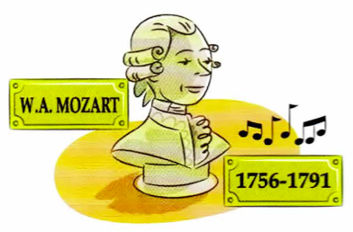
Past Simple
Study this example:
Wolfgang Amadeus Mozart was an Austrian musician and composer. He Lived from 1756 to 1791. He started composing at the age of five and wrote more than 600 pieces of music.
He was only 35 years old when he died.
Lived/ started/ wrote/ was/ died are all past simple.

Slide 12
Past Simple
B) Very often the past simple ends in -ed (regular verbs) :
• I work in a travel agency now. Before that I worked in a department store.
• We invited them to our party, but they decided not to come.
• The police stopped me on my way home last night.
• Laura passed her exam because she studied very hard.
But many verbs are irregular. The past simple does not end in -ed. For example:
write -> wrote Mozart wrote more than 600 pieces of music.
see -> saw We saw Tanya in town a few days ago. go -> went I went to the cinema three times last week.
shut -> shut lt was cold, so I shut the window.

Slide 13
Past Simple
C) In questions and negatives we use did/didn't+ infinitive (enjoy/see/go etc.):
But many verbs are irregular. The past simple does not end in -ed. For example:
• a: Did you go out last night?
b: Yes, I went to the cinema, but I didn't enjoy the film much.
• 'When did Mr. Thomas die?' 'About ten years ago.’
• They didn't invite us to the party, so we didn't go.
• 'Did you have time to do the shopping?' 'No, I didn't.’
In the following examples, do is the main verb in the sentence (did ... do I didn't do):
What did you do at the weekend? (not What did you at the weekend?)
I didn't do anything. (not I didn't anything)

Slide 14
Past Simple
D) The past of be (am/is/are) is was/were:
Note that we do not use did in negatives and questions with was/were:
• I was angry because they were late.
• Was the weather good when you were on holiday?
• They weren't able to come because they were so busy.
• Did you go out last night or were you too tired?

Slide 15
Past Simple
Exercises:
1. Read what Laura says about a typical working day:
a. She got up at 7 o’clock.
b. She …………….. a big breakfast.
c. She…………………………………….. .
d. It ……………………to get to work.
e. ………………………….. at 8.45.
f. ………………………… lunch.
g. ………………………… at 5 o’clock.
h. ………. tired when…………. home.
i. ………….. a meal yesterday evening.
j. ………………. Out yesterday evening.
k. ……………………….at 11 o’clock.
l. ………………….. well last night.

Slide 16
Past Simple
Exercises:
2. Complete the sentences using the following verbs in the correct form:
buy catch cost fall hurt sell spend teach throw write
a. Mozart wrote more than 600 pieces of music.
b. 'How did you learn to drive?' 'My father ….............. me.’ c. We couldn't afford to keep our car, so we ……….. it. d. Dave ............................. down the stairs this morning and …………………. his leg. e. Joe ....................................... the ball to Sue, who …………….it.
f. Ann ................... . a lot of money yesterday. She ………………a dress which …......... £100.

Slide 17
Past Simple
Exercises:
3. Complete the sentences. Put the verb into the correct form, positive or negative.
a. lt was warm, so I took off my coat. (take) b. The film wasn't very good. I didn’t enjoy it much. (enjoy)
c. I knew Sarah was busy, so I ......................................................... her. (disturb) d. We were very tired, so we ………………………................ the party early. (leave) e. The bed was very uncomfortable. I.... ................................................................... well. (sleep)
f. The window was open and a bird................................................in to the room. (fly)
g. The hotel wasn't very expensive. lt ………............................ much to stay there. (cost)
h. I was in a hurry, so I……………........................... time to phone you. (have)
It was hard carrying the bags. They ............................................................... very heavy. (be)

Slide 18
Past Simple
Answers:
1.
b) She had c) She walked to work
It took her (about) half an hour
She started work
She didn't have (any) lunch. / ... eat (any) lunch.
She finished work
She was tired when she got home.
She cooked
She didn't go
She went to bed
She slept
2. b) Taught
Sold
d) fell ... hurt
e) threw .. . caught
f) spent ... bought ... cost
3.
b) didn’t disturb
c) left
d) didn’t sleep
e) flew
f) didn’t cost
g) didn’t have
e) Were

Slide 19
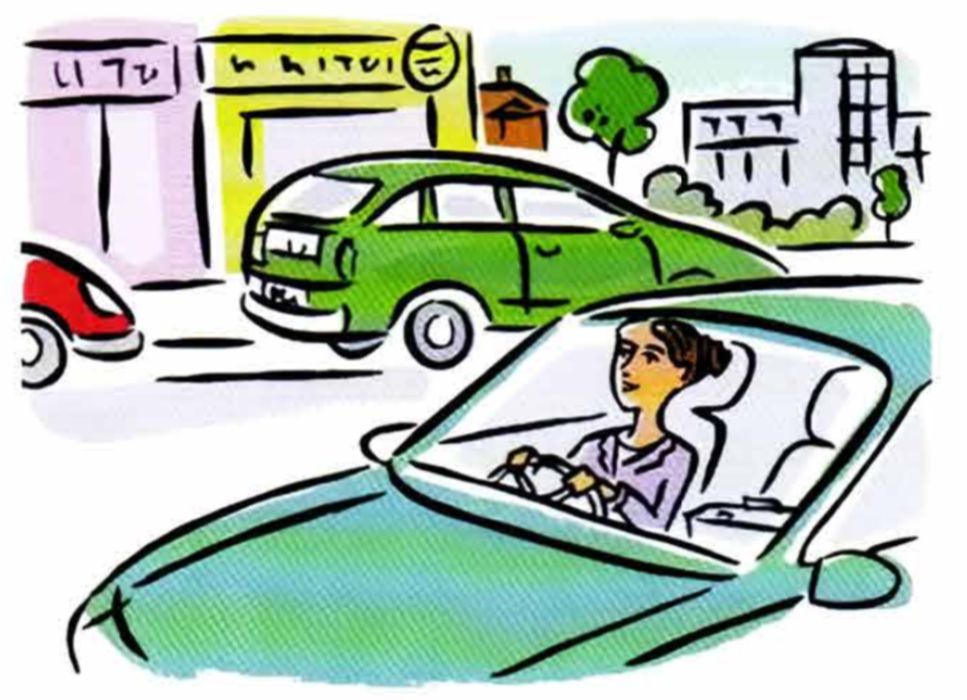
Present Continuous (I am doing)
A) Study this example situation:
Sarah is in her car. She is on her way to work.
She is driving to work.
This means: she is driving now, at the time of speaking.
The action is not finished.
Am/is/are+ -ing is the present continuous:

Slide 20
Present Continuous (I am doing)
B) I am=doing something = I'm in the middle of doing it; I've started doing it and I haven't finished:
• Please don't make so much noise. I'm trying t o work. (not I try)
• 'Where's Mark?' 'He's having a shower.' (not He has a shower)
• Let's go out now. It isn't raining any more. (not It doesn't rain)
• (at a party) Hi, Jane. Are you enjoying the party? (not Do you enjoy)
• What's all that noise? What's going on? (=What's happening?)
Sometimes the action is not happening at the time of speaking. For example:
Steve is talking to a friend on the phone. He says:

Slide 21
Present Continuous (I am doing)
C) You can use the present continuous with today / this week / this year etc. (periods around now}:
• a: You're working hard today. (not You work hard today)
b: Yes, I have a lot to do. • The company I work for isn't doing so well this year.
D) We use the present continuous when we talk about changes happening around now, especially with these verbs:
get change become increase rise fall grow improve begin start
Is your English getting better? (not Does your English get better) The population of the world is increasing very fast. (not increases) At first I didn't like my job, but I'm beginning to enjoy it now. (not I begin)

Slide 22
Present Continuous (I am doing)
Exercises:
1. The sentences on the right follow those on the left. Which sentence goes with which?

Slide 23
Present Continuous (I am doing)
2. Complete the conversations.
A) a: I saw Brian a few days ago.
b: Oh, did you? What’s he doing these days? (what / he / do)
a: He's at university.
b: ……………………….. ? (what / he / study)
a: Psychology.
b: ………………………… it? (he / enjoy)
a: Yes, he says it’s a very good course.
B) a: Hi, Nicola. How …………………………………..? (your new job / go).
b: Not bad. It wasn’t so good at first, but ………………………… better now. (it/ get)
a: What about Daniel? Is he ok?
b: Yes, but ……………………….. his work right now. (he / not / enjoy)
He’s been in the same job for a long time and ………………………….. to get bored with it. ( he/ begin)

Slide 24
Present Continuous (I am doing)
3. Put the verb into the correct form, positive (I'm doing etc.) or negative (I'm not doing etc.).
a. Please don't make so much noise I’m trying (I / try) to work.
b. Let's go out now It isn’t raining (it / rain) any more.
c. You can turn off t he radio. ………………………….(I/ listen) to it.
d. Kate phoned me last night. She's on holiday in France…………………………. (she / have) a great time and doesn't want to come back.
e. I want to lose weight, so this week ……………..………………………. (I / eat) lunch.
f. Andrew has just started evening classes……………………….(he / learn) Japanese.
g. Paul and Sally have had an argument………………………(they I speak) to each other.
h. ……………………………………………………….. (I / get) tired. I need a rest.
i. Tim………………………………………………………..(work) today. He's taken the day off.
j. ………………………………………………….(I I look) for Sophie. Do you know where she is?

Slide 25
Present Continuous (I am doing)
Answers:
1.
b) e
c) g
d) a
e) d
f) h
g) b
h) c
2.
A) What's / What is he studying
Is he enjoying
B) ‘s / is your new job going it’s getting / it is getting
he isn’t enjoying / he’s not enjoying
he’s beginning / he is beginning
3.
b) I'm not listening / I am not listening c) She's having / She is having d) I'm not eating / I am not eating e) He's learning / He is learning f) They aren't speaking / They're not speaking / They are not speaking g) I'm getting / I am getting h) isn't working / 's not working / is not working i) I'm looking / I am looking

Slide 26
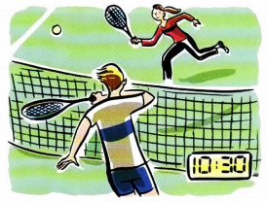
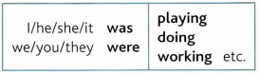
Past Continuous (I was doing)
A) Study this example situation:
Yesterday Karen and Jim played tennis. They started at 10 o'clock and finished at 11.30.
So, at 10.30 they were playing tennis.
They were playing = they were in the middle of playing.
They had not finished playing.
Was/were -ing is the past continuous:

Slide 27
Past Continuous (I was doing)
B) I was doing something = I was in the middle of doing something at a certain time. The action or situation had already started before this time, but had not finished:
• This time last year I was living in Brazil.
• What were you doing at 10 o'clock last night?
• I waved to Helen, but she wasn't looking.

Slide 28
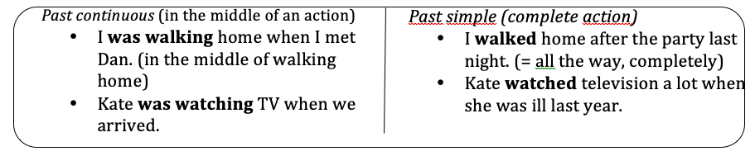
Past Continuous (I was doing)
C) Compare the past continuous (I was doing) and past simple (I did):
D) We often use the past simple and the past continuous together to say that something happened in the middle of something else:
• Matt phoned while we were having dinner.
• It was raining when I got up.
• I saw you in the park yesterday. You were sitting on the grass and reading a book.
• I hurt my back while I was working in the garden.

Slide 29
Past Continuous (I was doing)
Exercises:
What were you doing at these times? Write sentences as in the examples. The past continuous is not always necessary (see the second example).
a) (at 8 o'clock yesterday evening) I was having dinner .
b) (at 5 o'clock last Monday) I was on a bus on my way home . c) (at 10.15 yesterday morning)…………………………………………….. .
d) (at 4.30 this morning) ………………………………………………………. .
e) (at 7.45 yesterday evening) ………………………………………………………. .
f) (half an hour ago) …………………………………………………………………….. .

Slide 30
Past Continuous (I was doing)
Exercises:
2. Use your own ideas to complete the sentences. Use the past continuous.
a) Matt phoned while we were having dinner .
b) The doorbell rang while I ………………………………………………………. .
c) The car began to make a strange noise when we ……………………………………………………. .
d) Jessica fell asleep while she ………………………………………………………. .
e) The television was on, but nobody………………………………………………………. .

Slide 31
Past Continuous (I was doing)
Put the verb into the correct form, past continuous or past simple.

Slide 32
Past Continuous (I was doing)
Answers:
1.
c) I was working.
d) I was in bed asleep.
e) I was getting ready to go out.
f) I was watching TV at home.
2.
b) was having a shower
c) were driving home
d) was reading the paper
e) was watching it
3.
3.1 didn’t see….. was looking
3.2 met…were going…was going….had….were waiting / waited
3.3 was cycling…stepped… was going… managed…. didn’t hit

Slide 33
Present Perfect (I have done)
Study this example situation:
The present perfect simple is have/has+ past participle. The past participle often ends in -ed (finished/decided etc.), but many important verbs are irregular (Lost/done/written etc.).

Slide 34
Present Perfect (I have done)
B) When we say that 'something has happened', this is usually new information:
• Ow! I've cut my finger.
• The road is closed. There's been (there has been) an accident.
• (from the news) Police have arrested two men in connection with the robbery.
When we use the present perfect, there is a connection with now. The action in the past has a result now:
• 'Where's your key?' 'I don't know. I've lost it.' (= I don't have it now)
• He told me his name, but I've forgotten it. (= I can't remember it now)
• 'Is Sally here?' 'No, she's gone out.' (=she is out now)
• I can't find my bag. Have you seen it? (= Do you know where it is now?)

Slide 35
Present Perfect (I have done)
C) Note the difference between gone (to) and been (to):
• James is on holiday. He has gone to Italy. (= he is there now or on his way there)
• Jane is back home now. She has been to Italy. (= she has now come back)
You can use the present perfect with just, already and yet.
Just = a short time ago: • 'Are you hungry?' 'No, I've just had lunch.'
• Hello. Have you just arrived?
We use already to say that something happened sooner than expected:
• 'Don't forget to pay your electricity bill.' 'I've already paid it.’
• 'What time is Mark leaving?' 'He's already left.'
Yet = until now. Yet shows that the speaker is expecting something to happen. Use yet only in questions and negative sentences:
• Has it stopped raining yet?
• I've written the email, but I haven't sent it yet.

Slide 36
Present Perfect (I have done)
You can also use the past simple (did, went, had etc.) in the examples on this page. So you can say:
• 'Is Sally here?' 'No, she went out.' or 'No, she's gone out.’ • 'Are you hungry?' 'No, I just had lunch.' or 'No, I've just had lunch.'

Slide 37
Present Perfect (I have done)
Exercises:
1. Read the situations and write sentences. Use the following verbs in the present perfect:
arrive break fall go up grow improve lose
a) Tom is looking for his key. He can't find it. Tom has lost his key .
b) Lisa can't walk and her leg is in plaster. Lisa .
c) Last week the bus fare was £1.80. Now it is £2. The bus fare .
d) Maria's English wasn't very good. Now it is better. Her English .
e) Dan didn't have a beard before. Now he has a beard. Dan .
f) This morning I was expecting a letter. Now I have it. The letter .
g) The temperature was 20 degrees. Now it is only 12. The .

Slide 38
Present Perfect (I have done)
2. Put in been or gone.
a) James is on holiday. He's gone to Italy.
b) Hello! I've just .......................... to the shops. I've bought lots of things.
c) Alice isn't here at the moment. She's ...........................to the shop to get a newspaper.
d) Tom has ..................................... out. He'll be back in about an hour.
e) 'Are you going to the bank?' 'No, I've already .............................. to the bank.'

Slide 39
Present Perfect (I have done)
3. Complete B's sentences. Make sentences from the words in brackets.

Slide 40
Present Perfect (I have done)
Answers:
1.
b) Lisa has broken her leg.
c) The bus fare has gone up.
d) Her English has improved.
e) Dan has grown a beard.
f) The letter has arrived.
g) The temperature has fallen.
2.
b) been
c) gone
d) gone
e) been
3.
b) Yes, I've just seen her. / Yes, I have just seen her. or Yes, I just saw her.
c) He's already left. / He has already left. or He already left.
d) I haven’t read it yet. or I didn’t read it yet.
e) No, she’s already seen the film. / No, she has already seen… or No, she already saw….
f) Yes, they’ve just arrived. / Yes, they have just arrived. or Yes, they just arrived.
g) We haven’t told him yet. or We didn’t tell him yet.

Slide 41
Past Perfect (I had done)
Study this example situation:
The past perfect simple is had+ past participle (gone/ seen/ finished etc).
Sometimes we talk about something that happened in t he past:
• Sarah arrived at the party.

Slide 42
Past Perfect (I had done)
This is the starting point of the story. Then, if we want to talk about things that happened before this time, we use the past perfect (had ...):
• When Sarah arrived at the party, Paul had already gone home.
Some more examples:
• When we got home last night, we found that somebody had broken into the flat.
• Karen didn't want to go to the cinema with us because she'd already seen the movie.
• At first I thought I'd done the right thing, but I soon realized that I'd made a big mistake. The man sitting next to me on the plane was very nervous. He hadn't flown before.
or ... He had never flown before.

Slide 43
Past Perfect (I had done)
B) Compare the present perfect (have seen etc.) and the past perfect (had seen etc.):
C) Compare the past simple (Left, was etc.) and the past perfect (had left, had been etc.):

Slide 44
Past Perfect (I had done)
Exercises:
1. Read the situations and write sentences from the words in brackets.
a) You went to Sue's house, but she wasn't there.
(she / go / out) She had gone out .
b) You went back to your hometown after many years. It wasn't the same as before.
(it / change / a lot) .
c) I invited Rachel to the party, but she couldn't come.
(she / arrange / to do something else .
d) You went to the cinema last night. You got to the cinema late.
(the film I already I start .
e) It was nice to see Daniel again after such a long time.
(I / not / see / him for five years) .
f) I offered Sue something to eat, but she wasn't hungry.
(she I just I have I breakfast) .

Slide 45
Past Perfect (I had done)
2. For each situation, write a sentence ending with never ... before. Use the verb in brackets.
a) The man sitting next to you on the plane was very nervous. lt was his first flight.
(fly) He’d never flown before .
b) Somebody sang a song. I didn't know it.
(hear) I before.
c) Sam played tennis yesterday. He wasn't very good at it because it was his first game.
(play) He .
d) Last year we went to Mexico. It was our first time there.
(be there) We .
3. Put the verb into the correct form, past perfect (I had done) or past simple (I did).
a) 'Was Paul at the party when you arrived?' 'No, he had gone (go) home.’ b) I felt very tired when I got home, so I (go) straight to bed.
c) The house was very quiet when I got home. Everybody (go) to bed.
d) Sorry I'm late. The car (break) down on my way here.
e) We were driving along the road when we (see) a car which (break) down, so we (stop) to help.

Slide 46
Past Perfect (I had done)
Answers:
1.
b) It had changed a lot.
c) She'd arranged to do something else. / She had arranged ... d) The film had already started.
e) I hadn't seen him for five years.
f) She'd just had breakfast. I She had just had ...
2.
b) I'd never heard it before. / I had never heard ... c) He'd never played (tennis) before. / He had never played ... d) We'd never been there before. / We had never been ...
3.
b) went
c) had gone
d) broke
e) saw…..had broken….stopped

Slide 47
Parabéns! Você chegou ao fim do material.
A CyberMind agradece a confiança e esperamos que todo o conhecimento adquirido seja aplicado em sua vida profissional. Sucessos!

